Slide 1

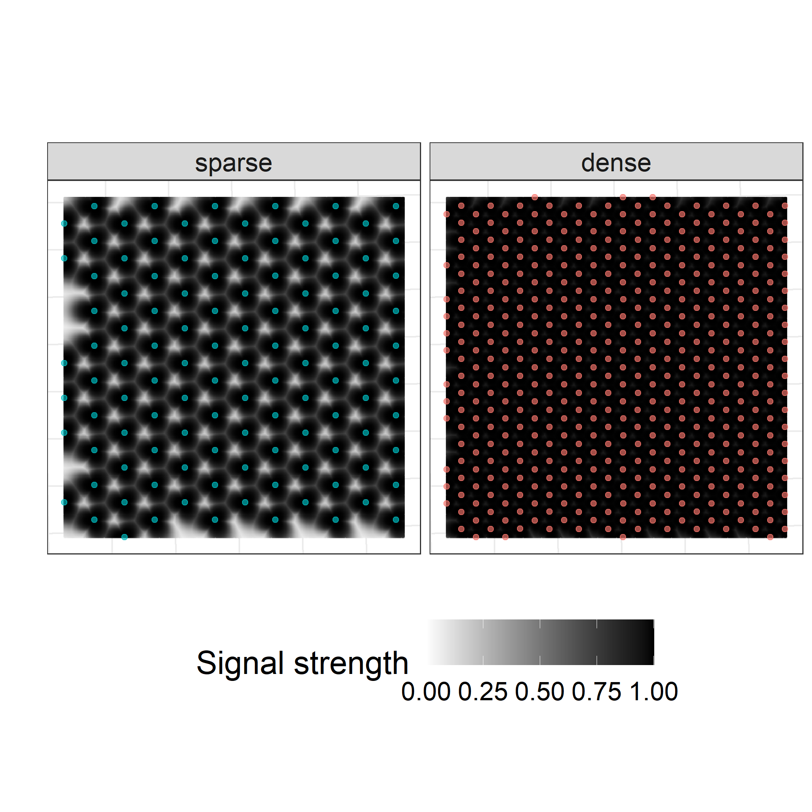
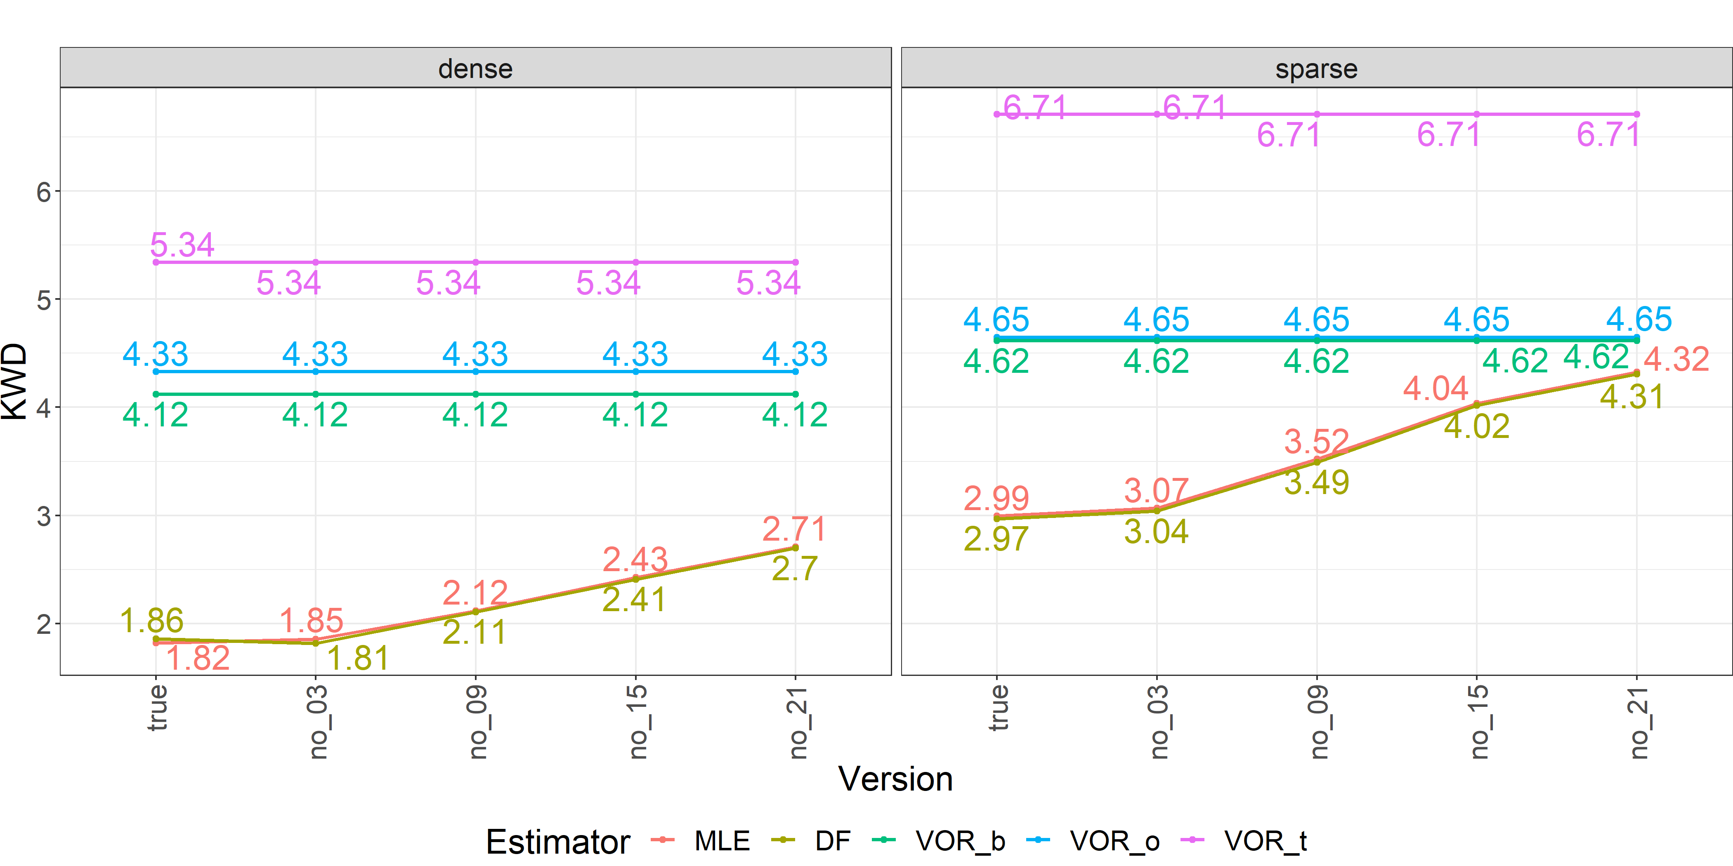
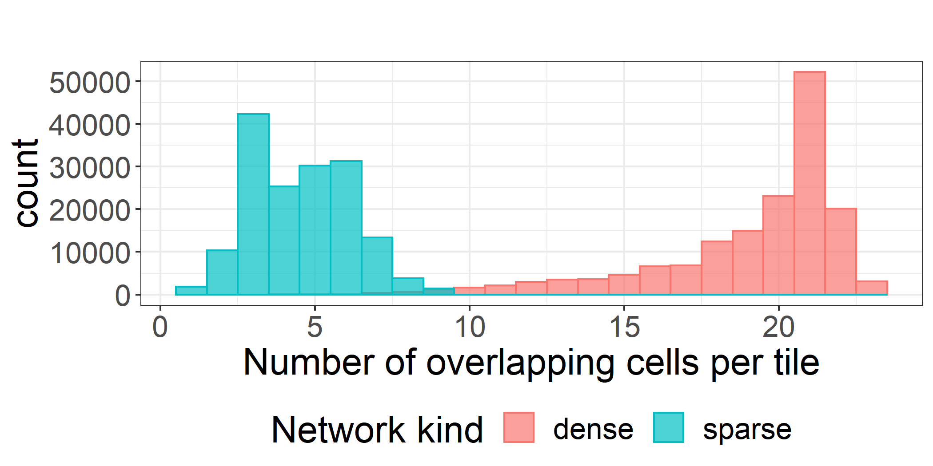
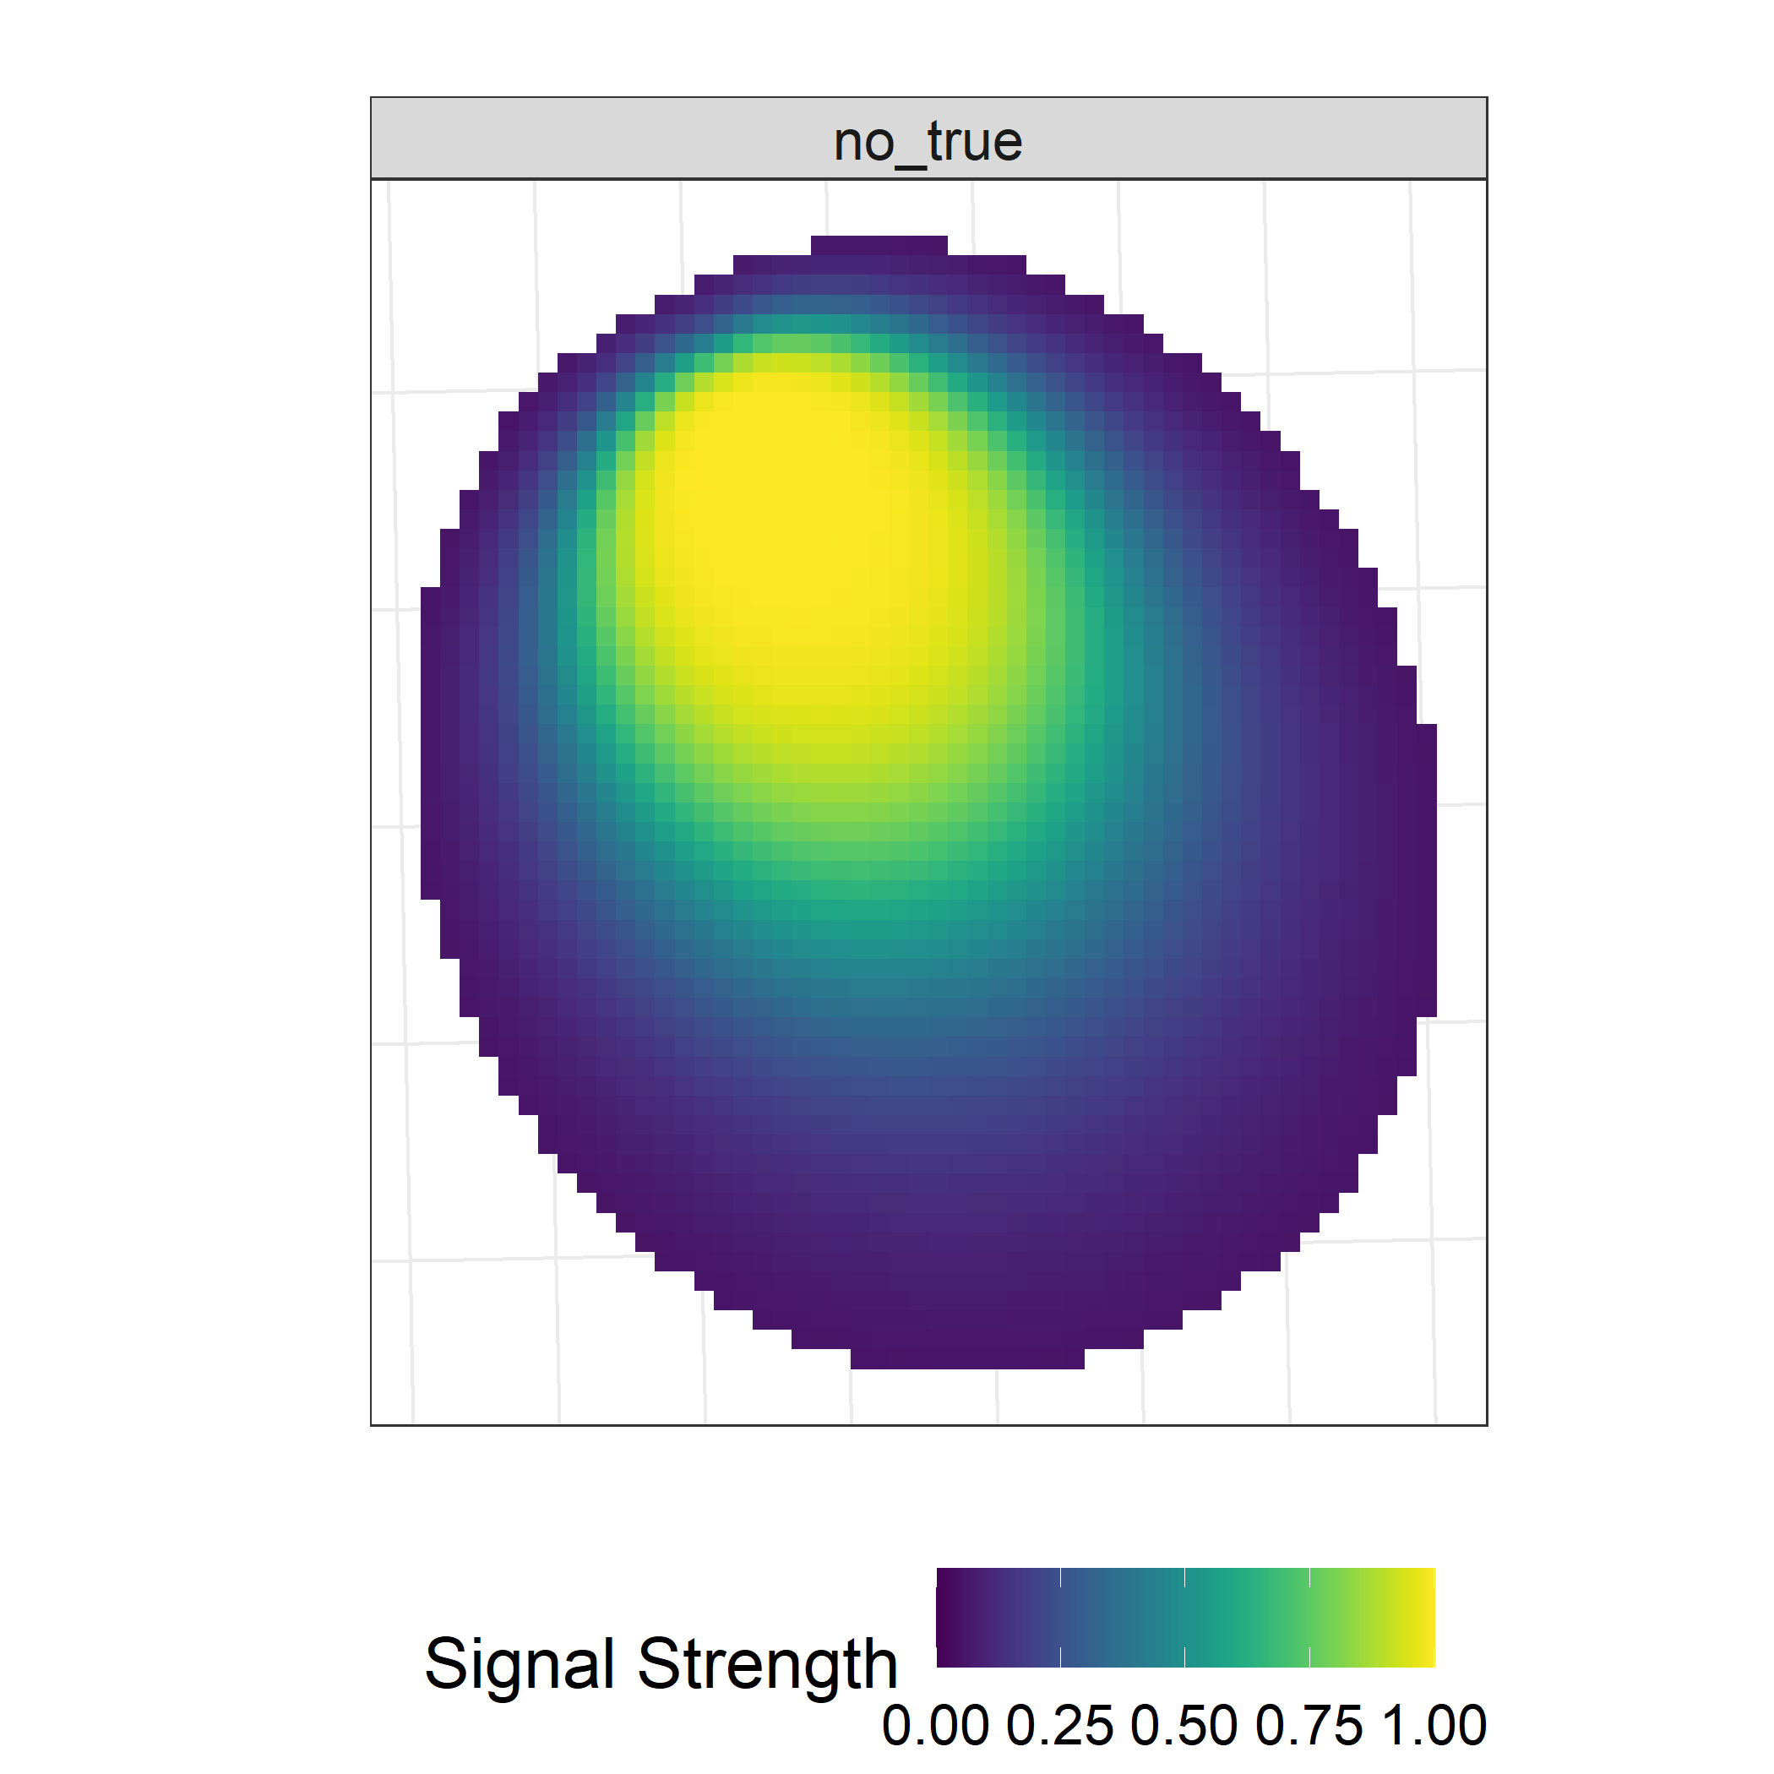
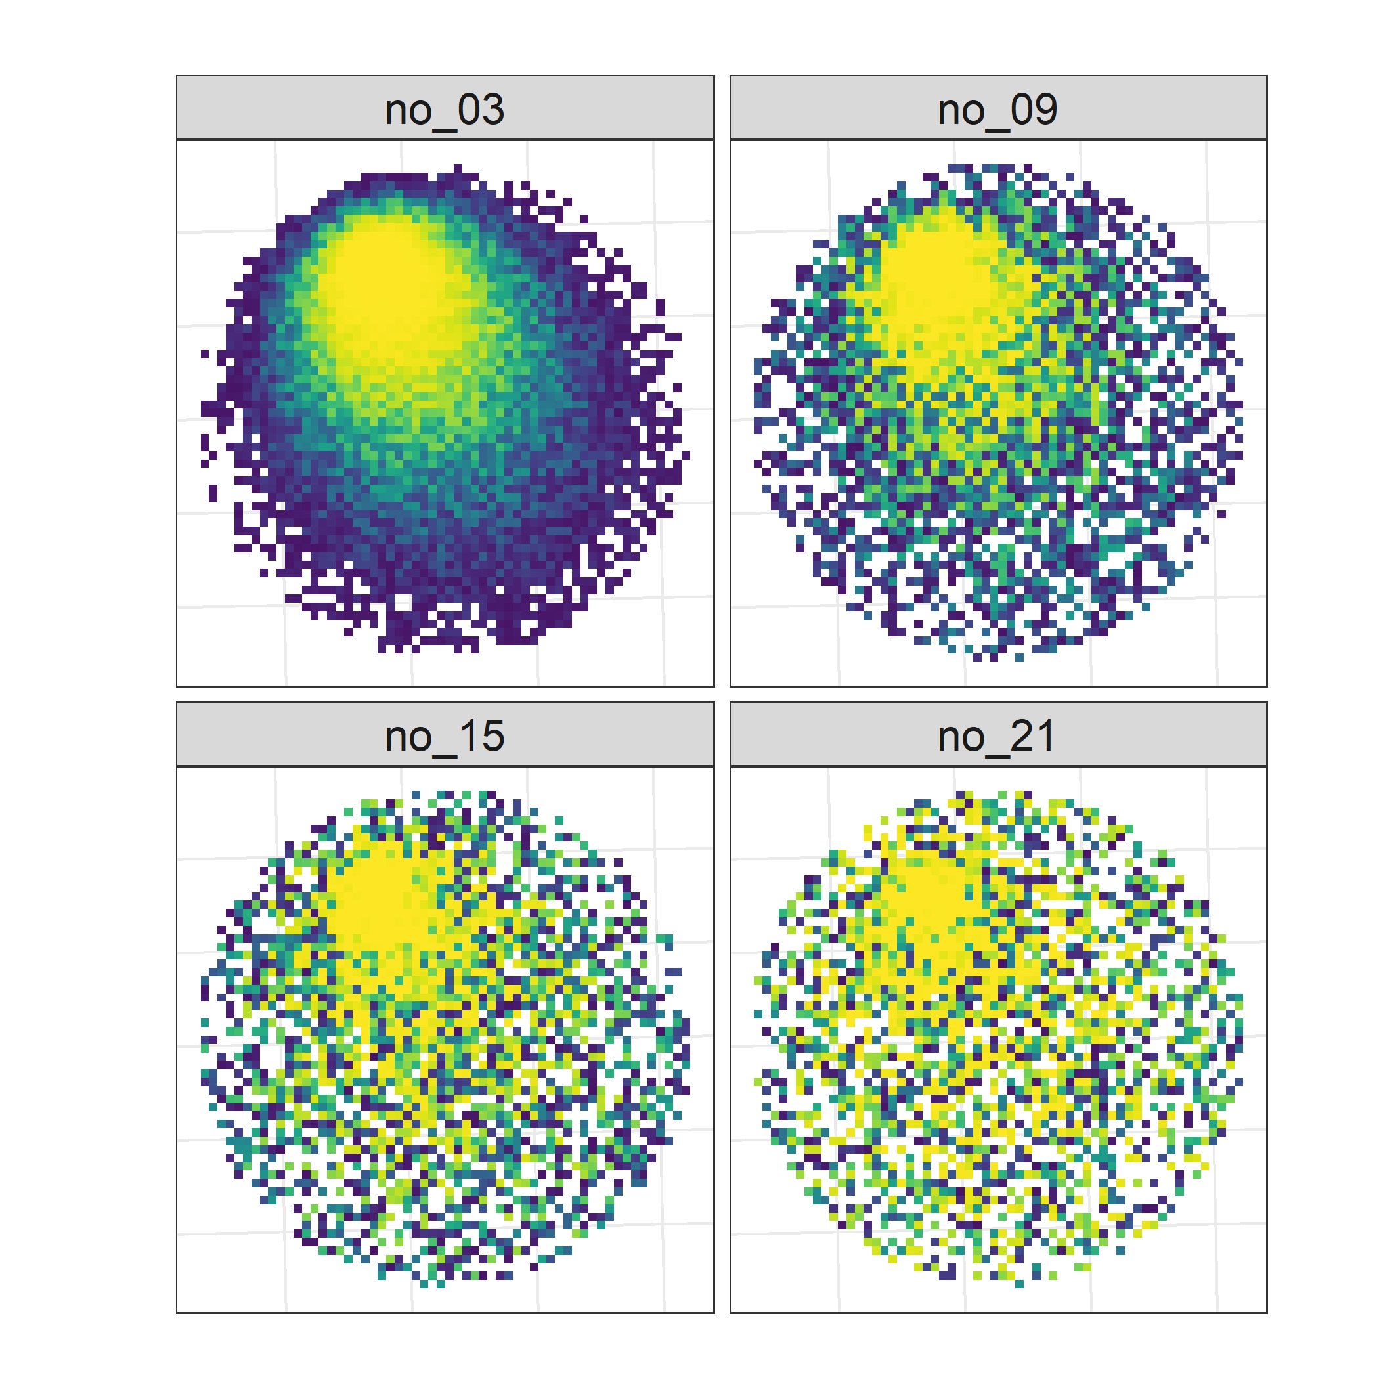
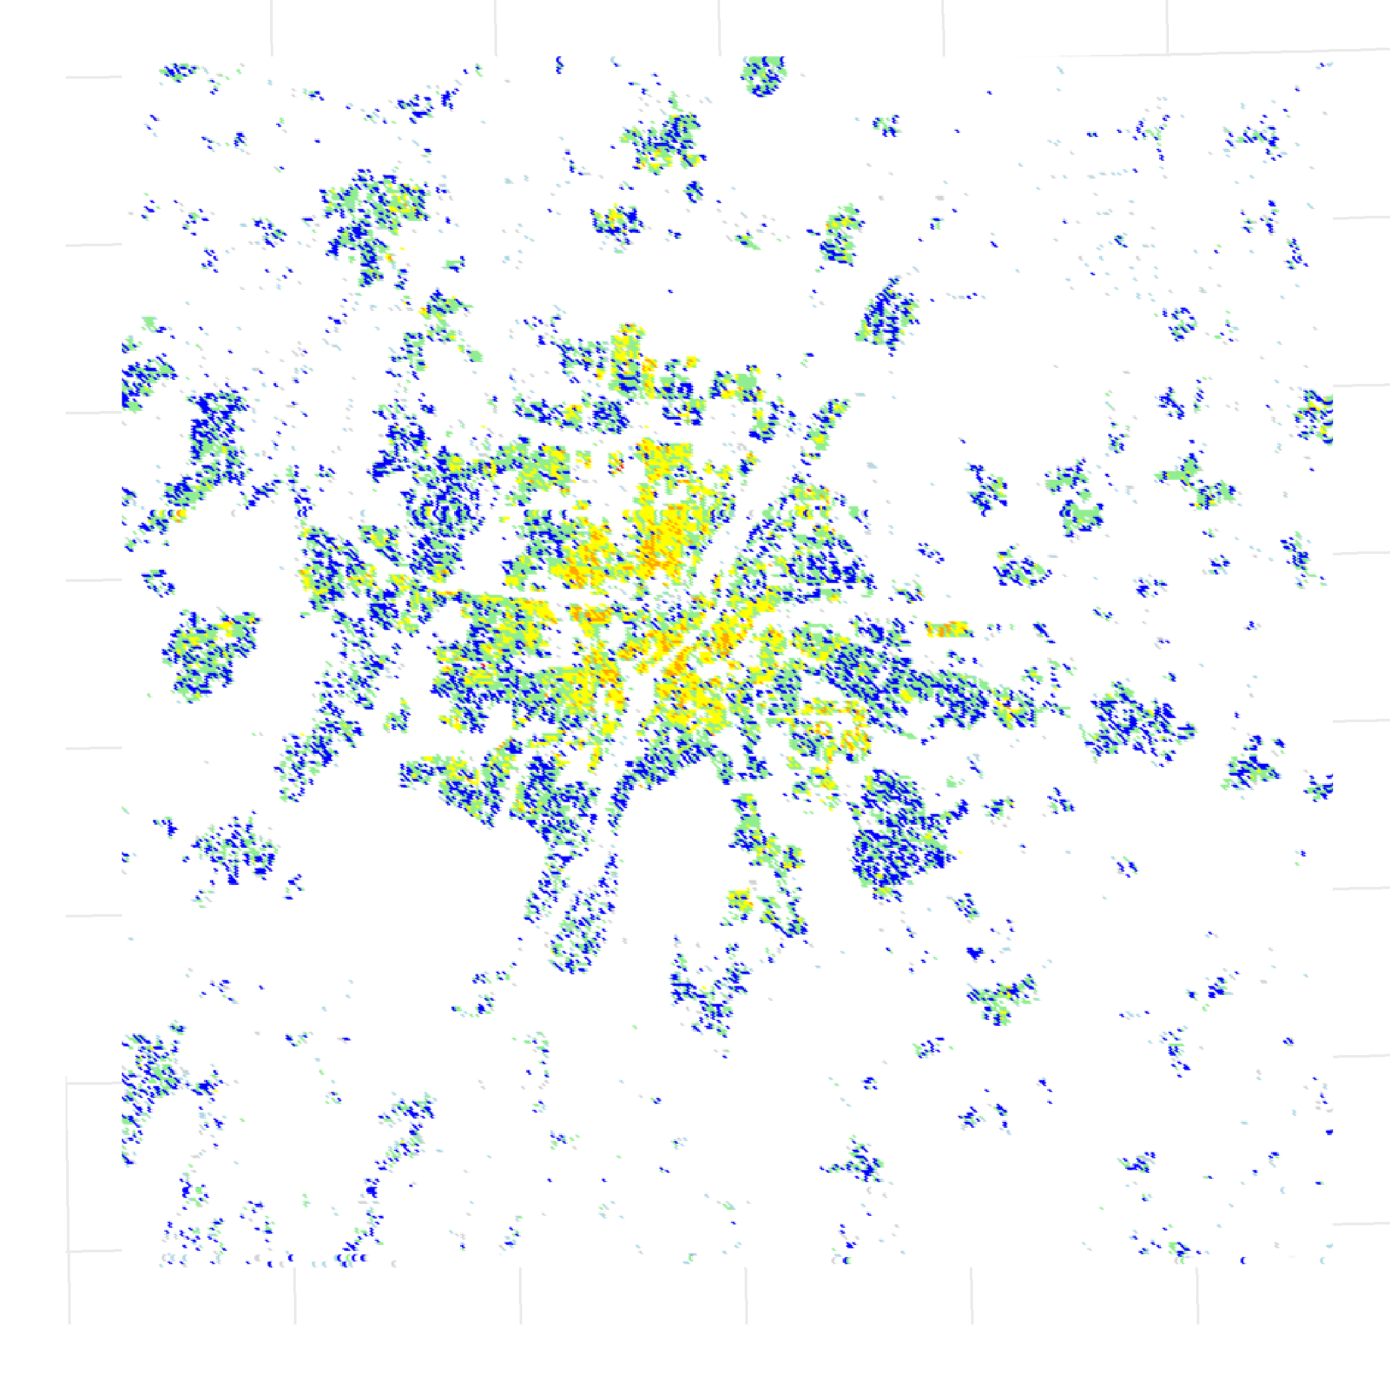
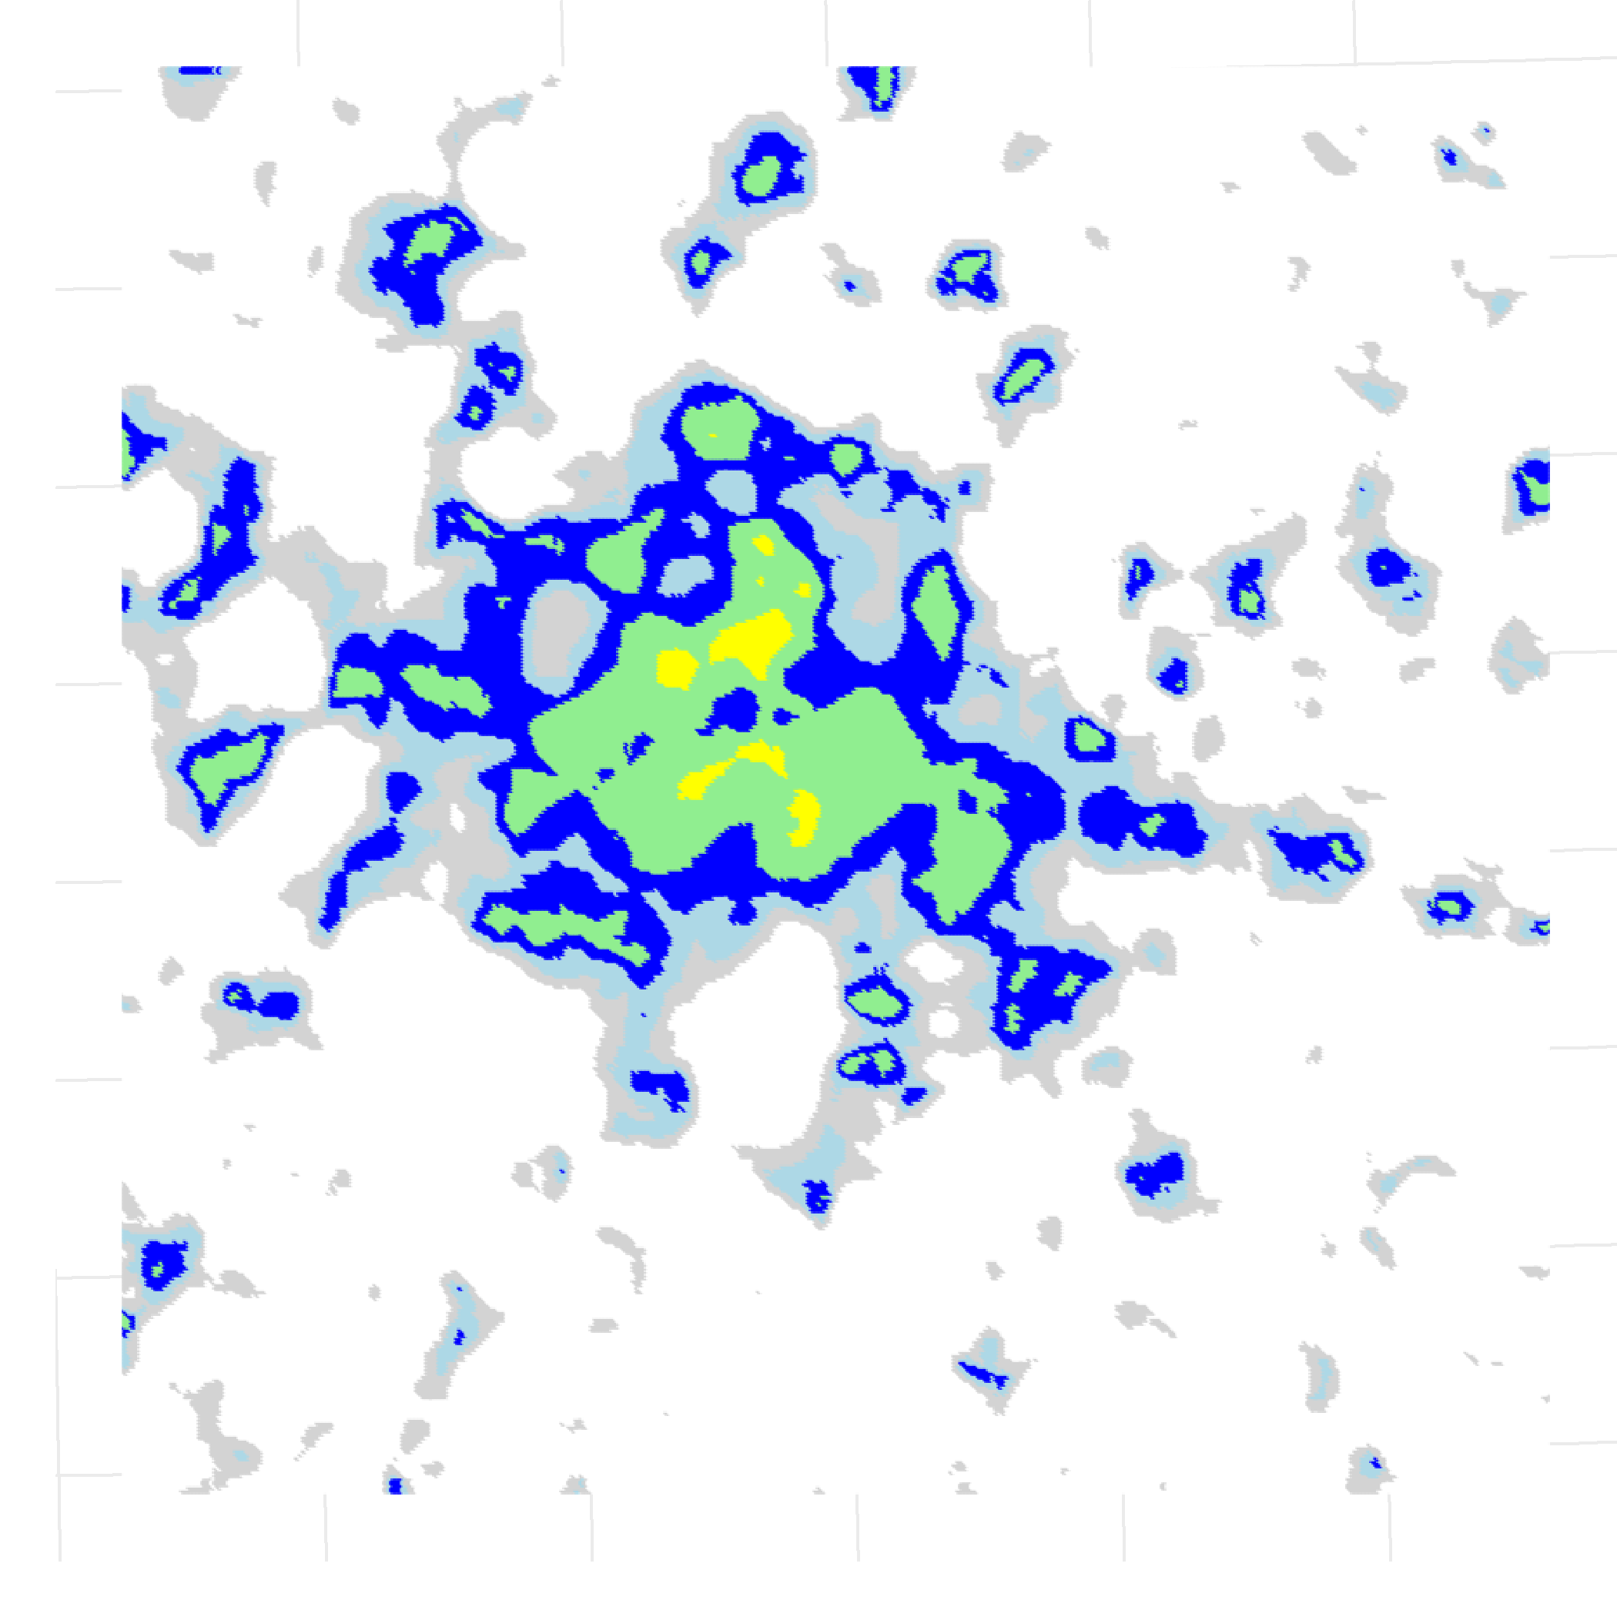
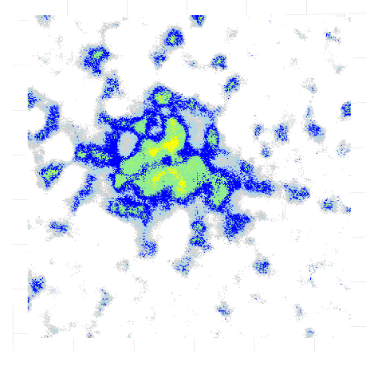
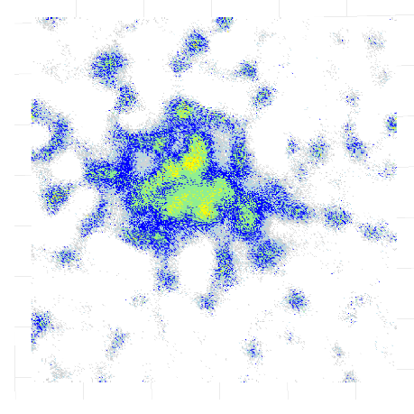
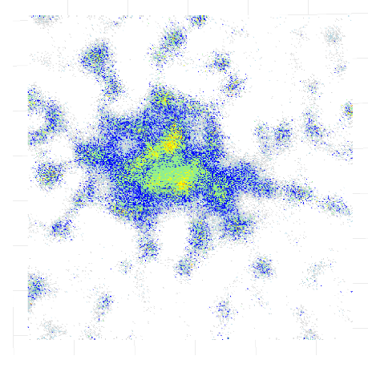
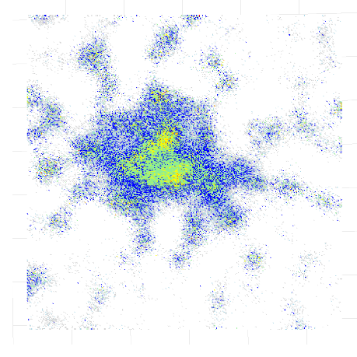
A sensitivity analysis concerning spatial density estimation with MNO data
Repository and references
Authors: Marco Ramljak¹, Fabio Ricciato², Peter Lugtig¹
(1) Corresponding author (m.l.ramljak@students.uu.nl) Utrecht University, (2) Eurostat
Research Intent
Simulation Study Design
Mobile Network Operator (MNO) data offer a rich source for estimating the spatial distribution of mobile phones at a given point in time. We compare two kinds of estimation strategies: (1) the traditional Voronoi tessellation and variants thereof, which exclusively assume that every mobile phone connects to its nearest cell (deterministic), (2) recently introduced estimators that are based on radio propagation modeling (RPM) through additional cellular network information (probabilistic). We know that RPM pays off in terms of spatial accuracy if the model information is of perfect quality, however, how high-quality does the model information need to be?
For this, we have developed two research questions:
RQ1: How robust are estimation strategies to network model mismatching errors (information quality)?
RQ2: How sensitive are estimation strategies to network characteristics, such as cell density?
100m x 100m grid (1,600 km², right-tailed population distribution, Munich)
For RQ2, two synthetic cellular networks (dense and sparse)
Mimicking cell counters and developing the ground truth RPM
Toyworld Generation
Estimation
Evaluation
Voronoi estimators: Tower (VOR_t), antenna offset (VOR_o), barycenter (VOR_b)
RPM estimators: MLE, DF
For RQ1, model mismatch introduced through spatially sensitive random noise
Kantorovitch-Wasserstein distance (KWD) to measure the degree of horizontal spatial error
Spatial density maps
Key Results
A) Network characteristics
To reserach the effect of network characteristics, we developed two networks of different directional cell-density levels (Fig. 1). Each network leads to a different distribution of overlapping cells per 100m x 100m tile (Fig. 2).
Fig. 1 Two synthetic cellular networks
Fig. 2 Cell overlap per tile
Fig. 4 KWD values for all simulated versions
B) Model mismatch To research the effect of cellular network information quality, we introduce spatially sensitve, random noise that distorts the modeled cell coverage profiles. These noised distortions resemble shaded versions of information quality.
C1) Evaluation Lower KWD values resemble higher similarity to the ground truth density in terms of spatial accuracy. Even in the sparse network scenario the RPM estimators with severly noised cell profile models perform much better (Fig. 4). The selected spatial density maps (Fig. 5) reveal how the model mismatch is translated into the estimation.
Ground truth spatial density
MLE - Perfect model information
MLE – no_03
MLE – no_09
Model mismatch
?
MLE – no_15
MLE – no_21
Fig. 3 Model mismatch on exemplary cell profile through random noise
Fig. 5 Selected spatial density maps (comparing ground truth with MLE estimations of the dense network)
Key Takeaways
For RQ1: Even with severe model mismatch, RPM estimators lead always to spatially more accurate results than any Voronoi estimator.
For RQ2: Higher network density offers more information and can therefore lead to spatially more accurate results than sparse networks. RPM estimtators utilize this information more than Voronoi estimators.
RPM is a complex task, however, in terms of spatial accuracy, it pays off because it allows to model overlapping cells. Our research shows that RPM estimators perform well under different network characteristics and are robust to severe model mismatching errors. Therefore, RPM estimators should be prefered as they utilize various information levels much better than Voronoi estimators. This research project will be extended through more networks (e.g. network layers) and mismatch versions (e.g. quantization, blurring).
Notes:
Prints as 33.1 x 46.8 (A0) at 100%. When printed using the library printing service, this will require trimming from 36 inch wide paper. To fill 36 inch paper roll, scale to 108.5% (prints as ~ 36 X 51).

